Slide 1
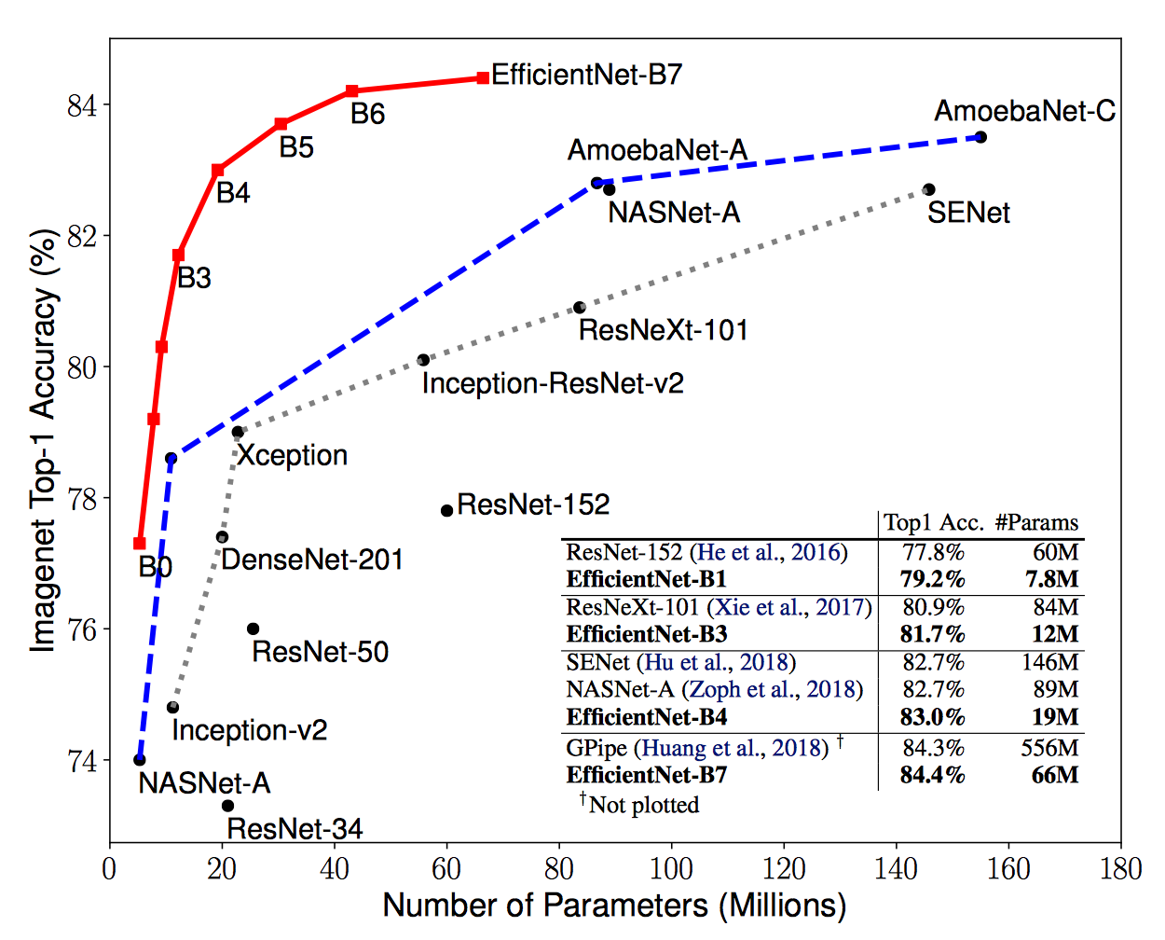
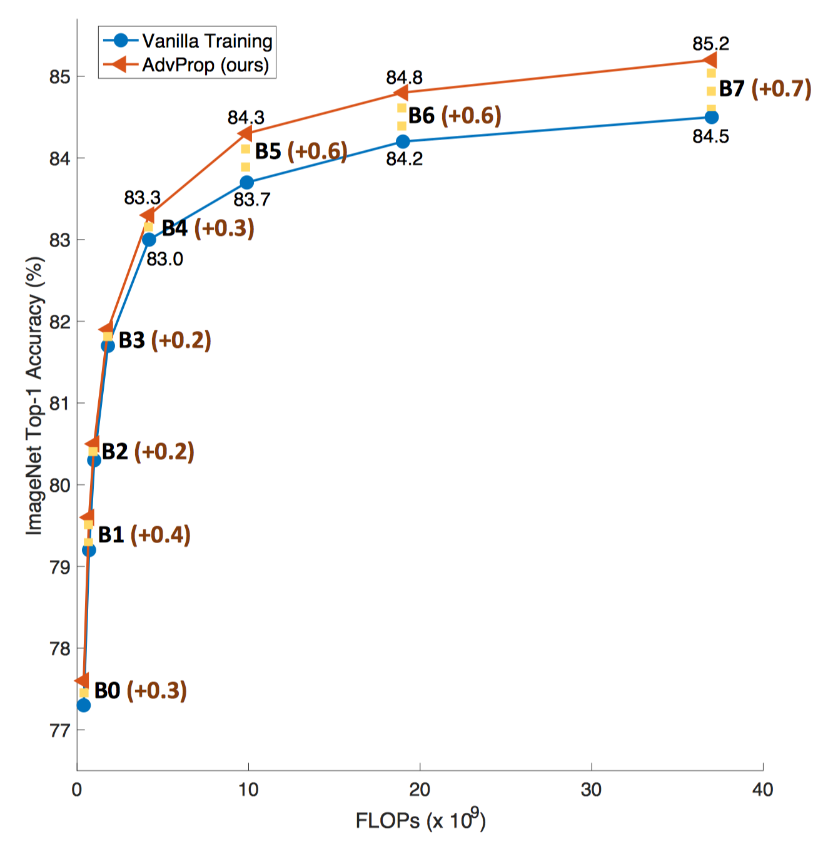
EfﬁcientNet + AdvProp

Slide 2
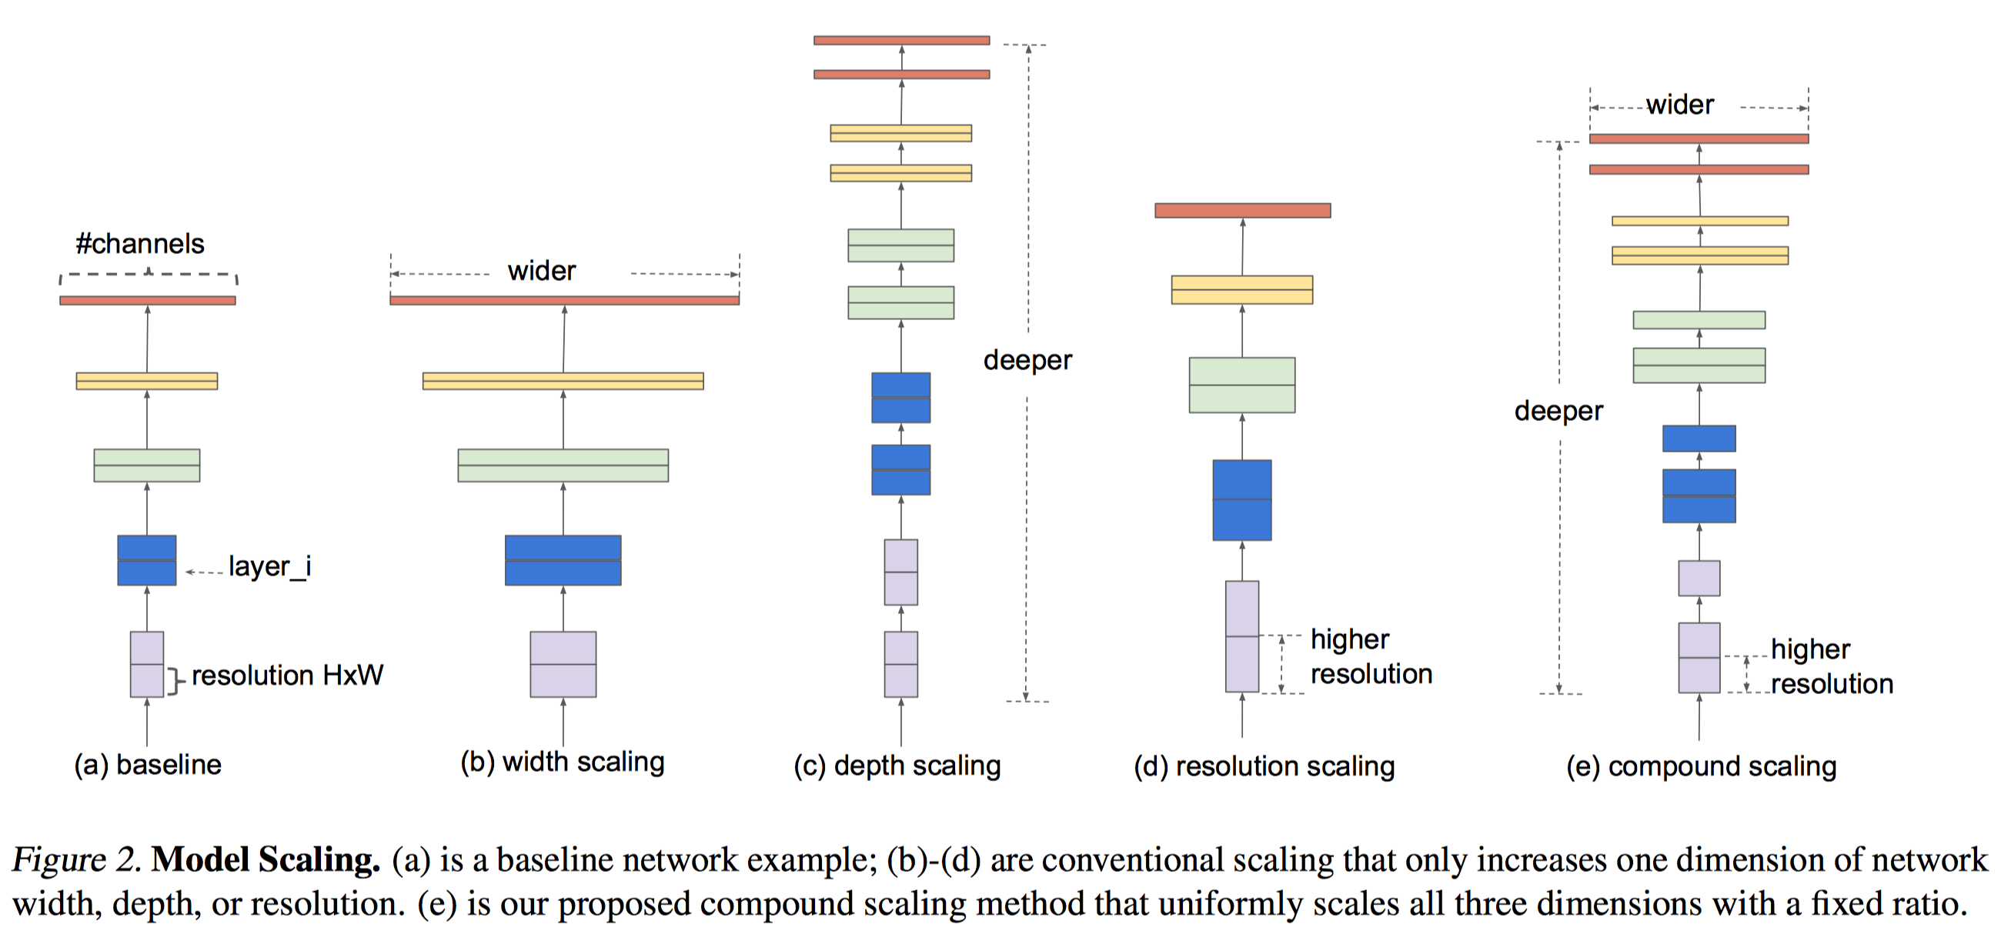
EfﬁcientNet
A new scaling method that scales all dimensions of depth/width/resolution using a compound coefﬁcient.
Depth: Capture richer and more complex features.
Width/Resolution: Capture more ﬁne-grained patterns.

Slide 3
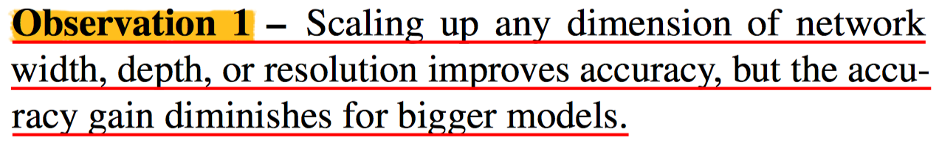
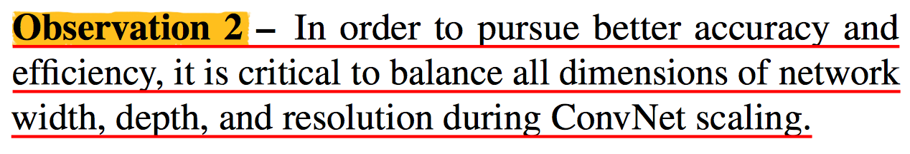
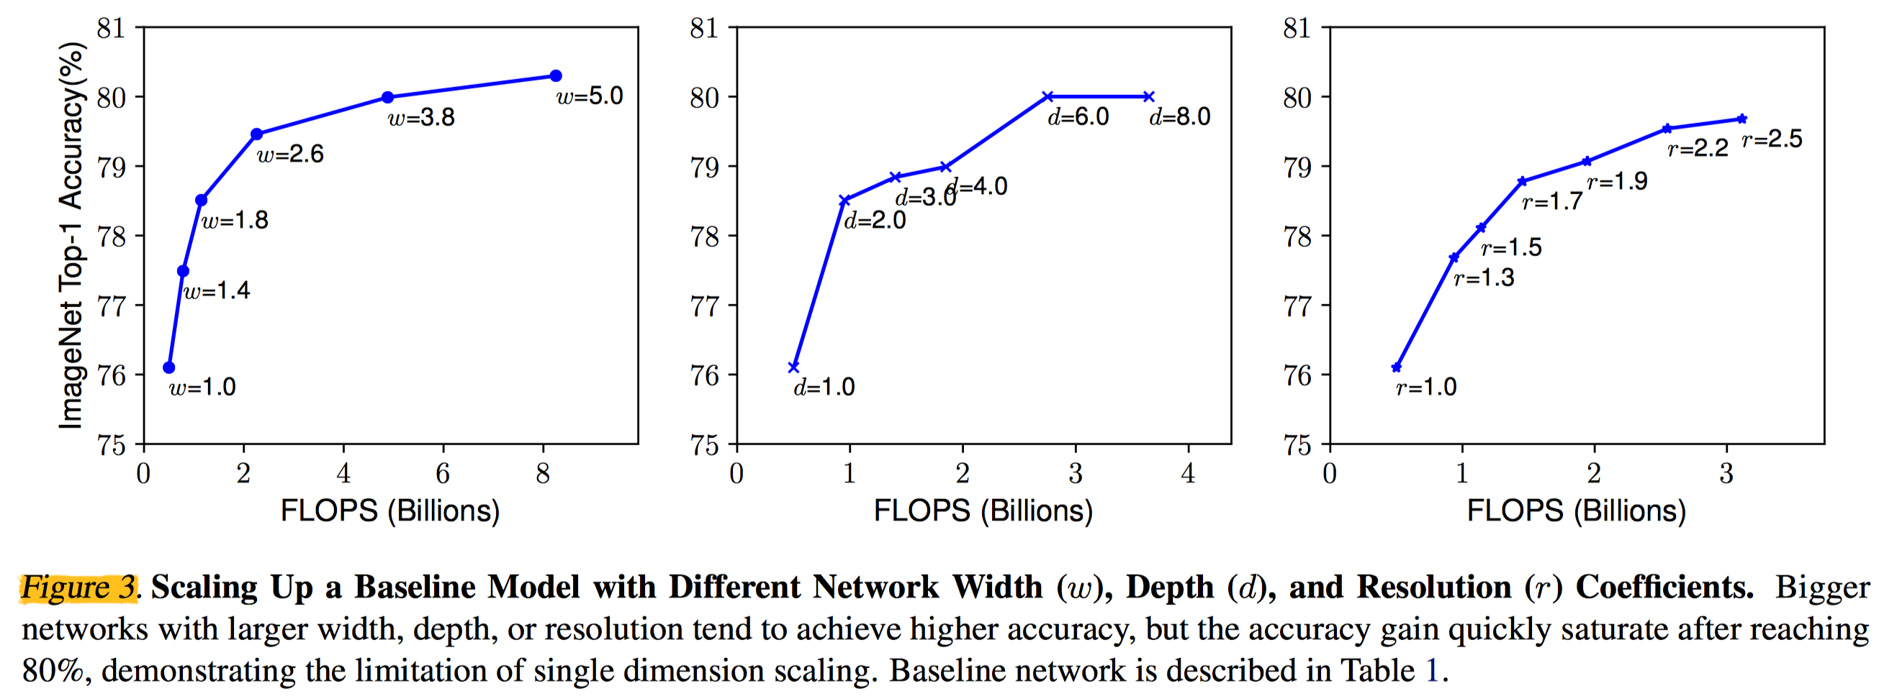
EfﬁcientNet

Slide 4
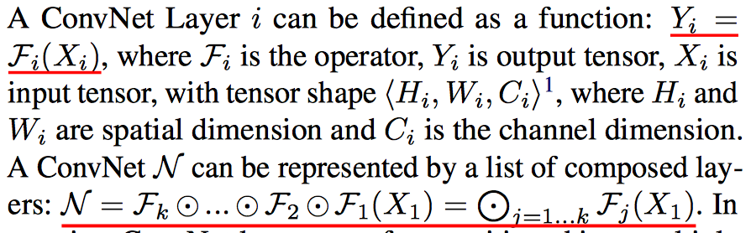
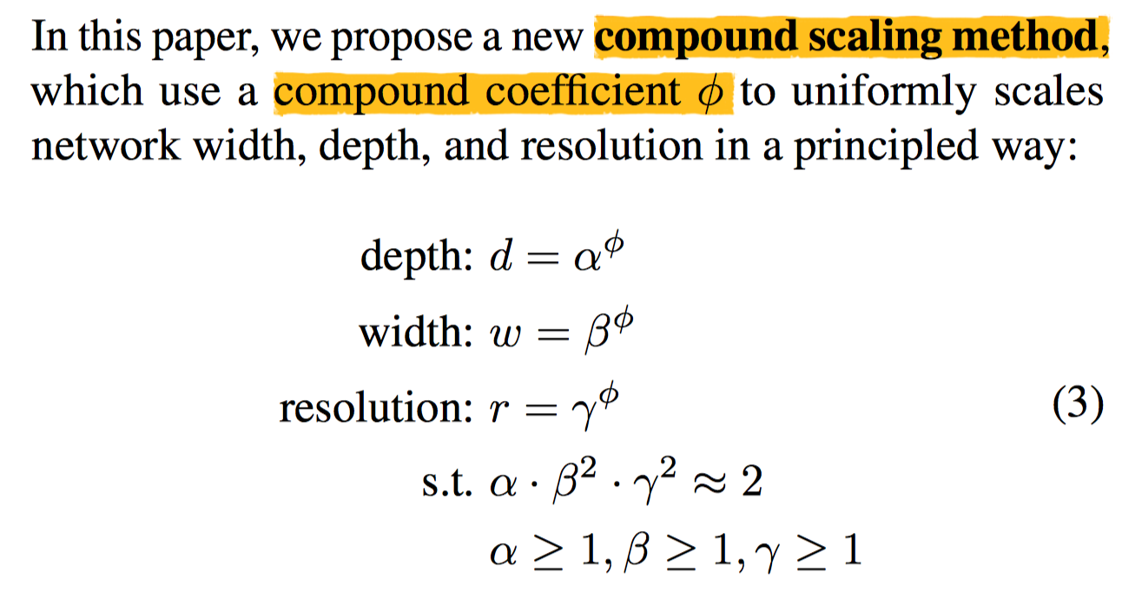
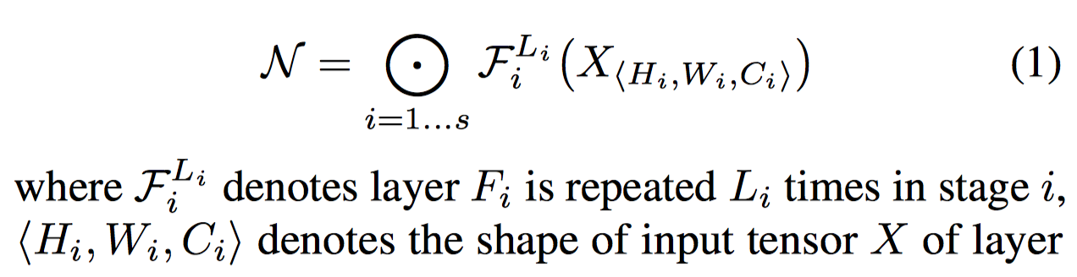
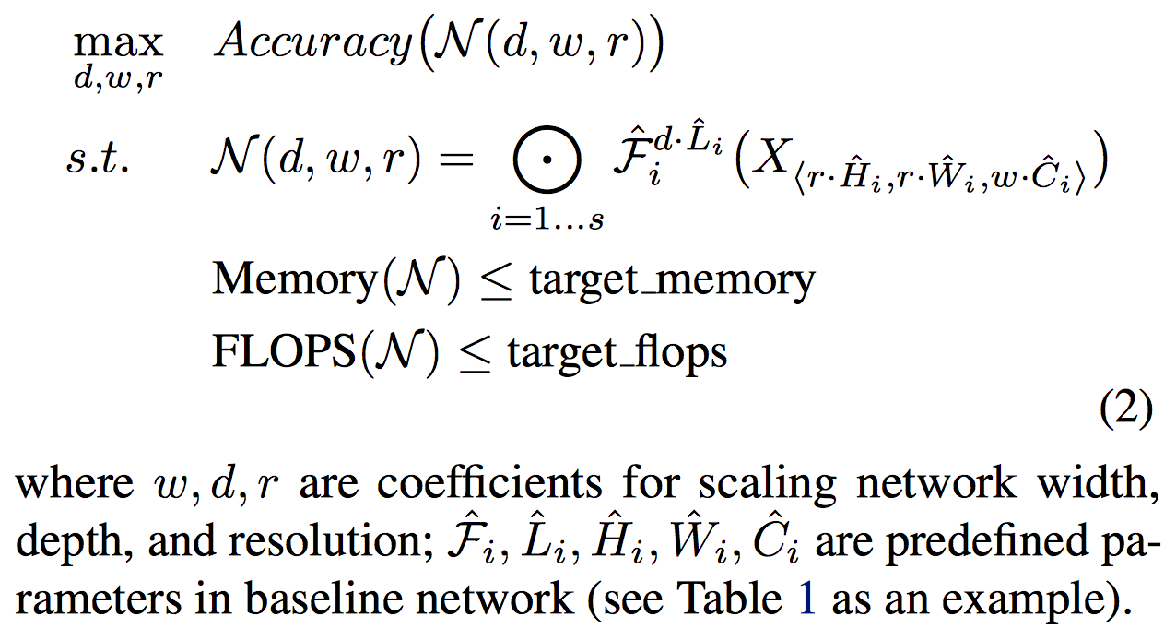
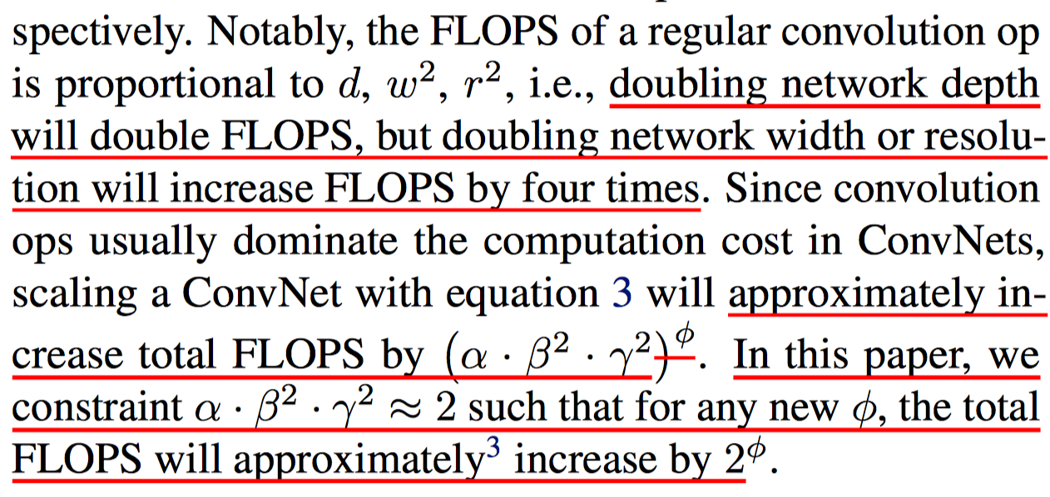
EfﬁcientNet

Slide 5
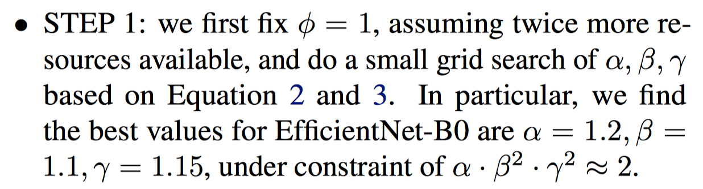
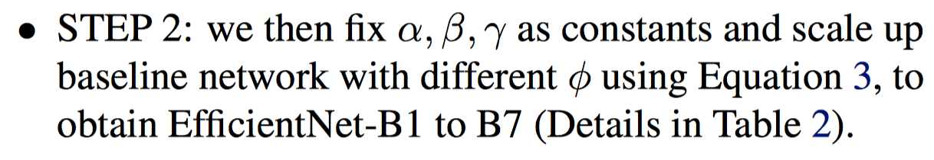
EfﬁcientNet

Slide 6
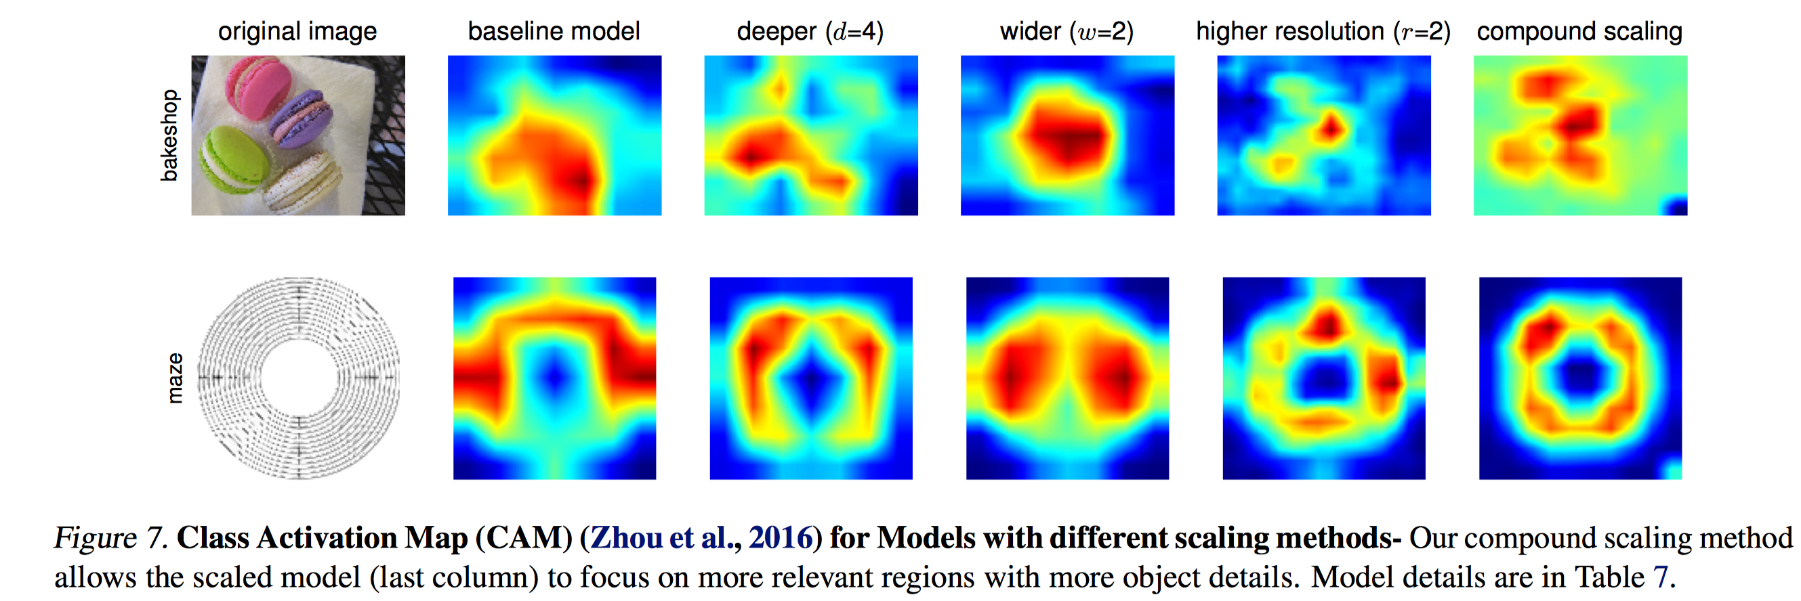
EfﬁcientNet

Slide 7
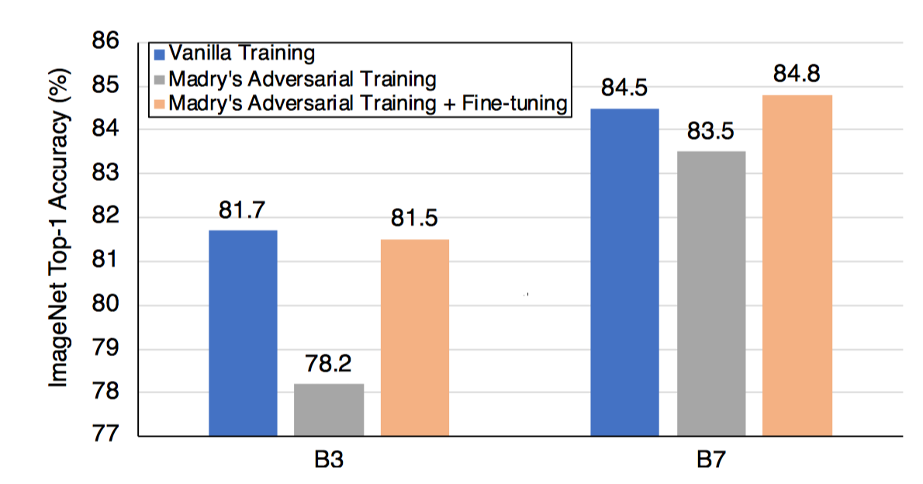
Adversarial Examples Improve Image Recognition
Adversarial examples can be used to improve image recognition models if harnessed in the right manner.
Distribution mismatch between clean examples and adversarial examples is a key factor that causes the performance degradation in previous works
AdvProp: The two batchnorms properly disentangle the two distributions at normalization layers for accurate statistics estimation.

Slide 8
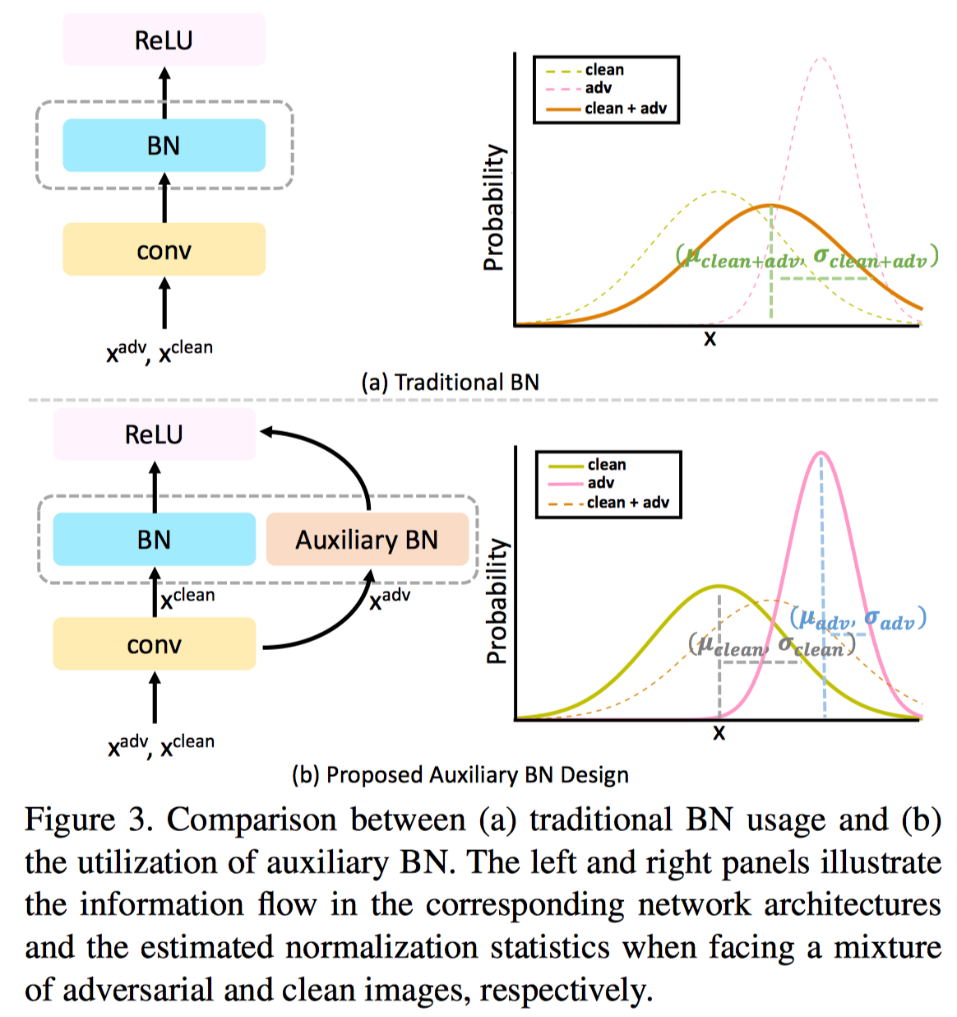
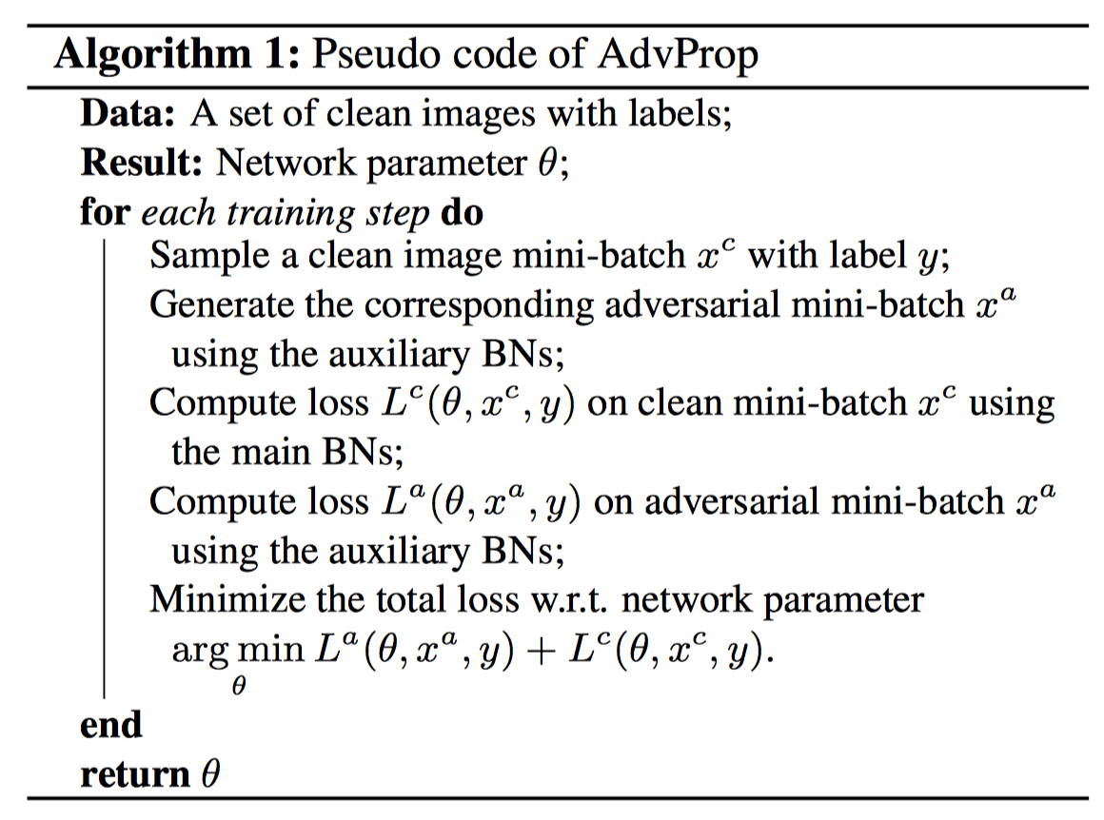
Adversarial Examples Improve Image Recognition

Slide 9
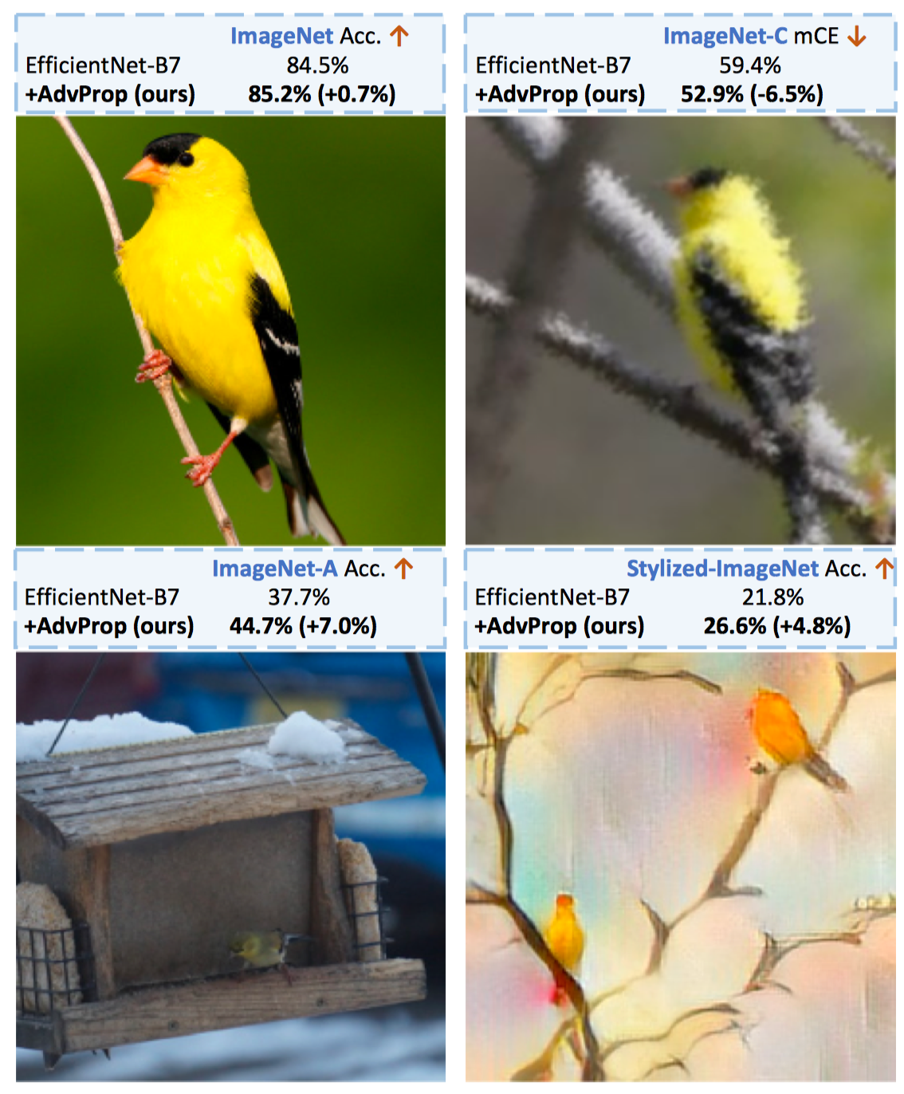
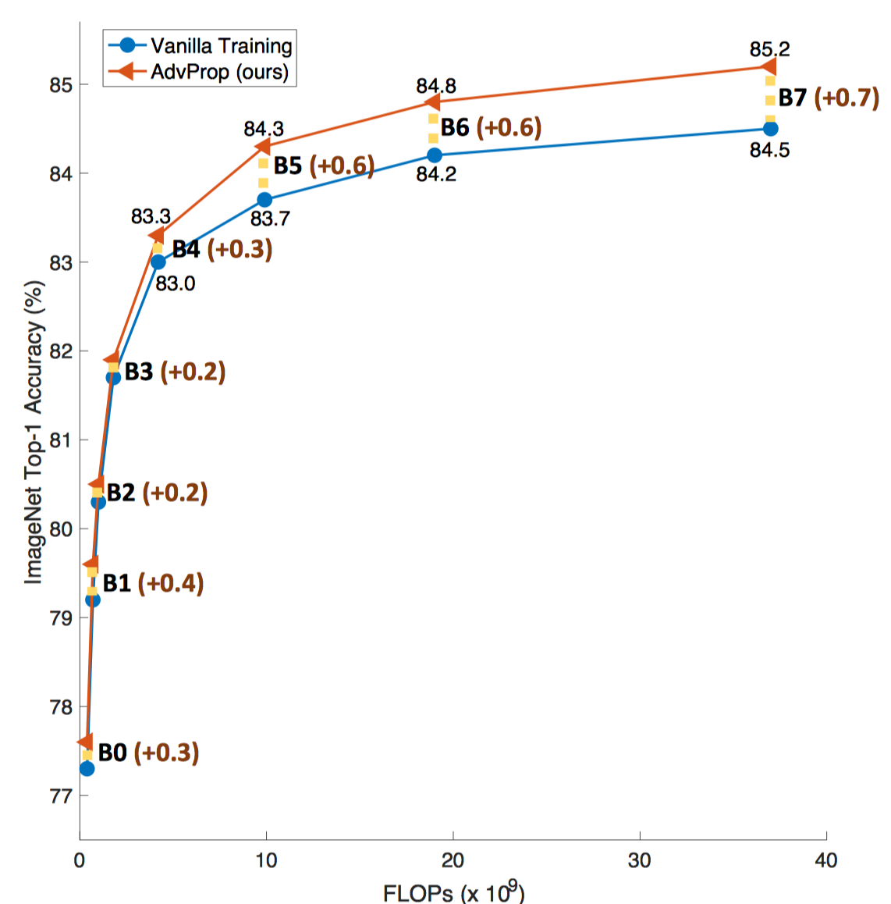
Adversarial Examples Improve Image Recognition

